Slide 1
Week-05:
Try/Catch
Method Overloading
Method parameters (Pass by value)
Final & enumerated types
Holding a reference to other objects

Slide 2
Here’s the thing…if we throw an exception…
This isn’t always true…there are some exceptions that we don’t have to handle but we still should!
We have to handle it!
We can handle it one of two ways…
Throw the exception to the previous method in the stack to let it handle the exception
Use a Try/Catch(/Finally) to trap the exception.
It turns out that some exception sub-types are unchecked which means that we don’t have to handle them…but that is something for another course. In this course, we will only use the Exception class which is checked and needs to be handled

Slide 3
Try/Catch
trycatch.Start

Slide 4
The Exception Chain
The JVM doesn’t want to terminate the program
The JVM will keep trying to find a try/catch to handle the exception that we’ve thrown.
If it can’t find it in the current method, it looks in the next highest stack frame.
If it doesn’t find it in the next stack frame, it keeps going through all of the stack frames, looking for a method with a try/catch to handle it.
If it runs out of stack frames, it has no choice but to terminate the program. That’s when we see the stackdump
This is one of the reasons that we need to understand the stack!!!

Slide 5
The Exception Chain
exceptionchains.Start

Slide 6
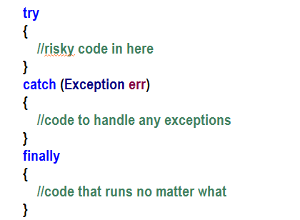
Try, Catch (and Finally and Try with resources)
If any of the code inside the try code-block causes an exception, execution immediately jumps to the catch code-block and passes the exception object as an argument.
We write code in this block to handle the error gracefully or to throw an exception which we will discuss later
No matter what happens, the finally block of code always runs!
Notes:
Finally and Try with Resources are outside of the scope of this course

Slide 7
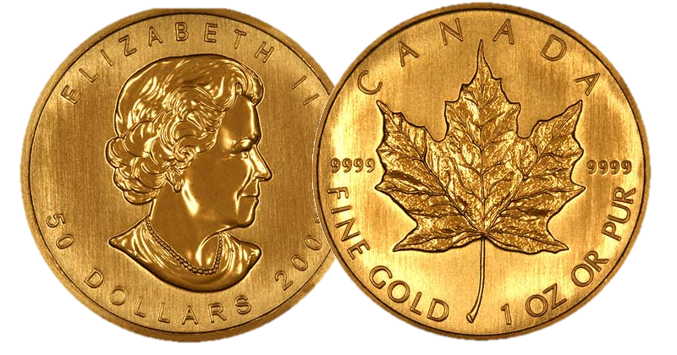
Important!!!
Exceptions stop the program flow when something is wrong
Try/Catch attempts to prevent Exceptions from terminating the program

Slide 8
yourturn0.Start

Slide 9
Managing Inputs with Exceptions
Week05.fixingourinput

Slide 10
Passing values to methods
Week-05:passbyvalue:Start

Slide 11
Bottom line
Java is always pass-by-value (we pass the value and only the value to the method)
However, remember that reference variable holds the address of how to get to an object.
If we pass a reference variable, we are passing the value that is in it but that value is still the address of an object so the receiving method can still directly access the object!

Slide 12
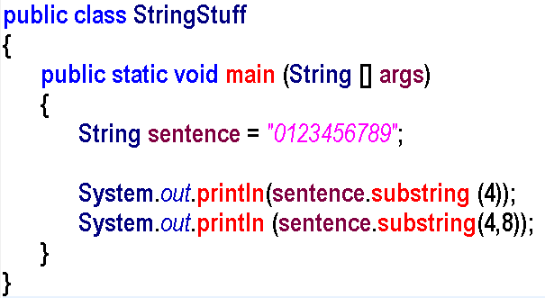
Let’s look at this…
The method substring can accept either 1 argument or 2 arguments
How can this be???
Introducing method overloading...

Slide 13
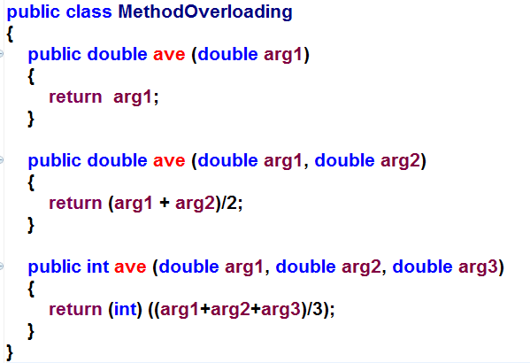
Method overloading
It turns out that we can write the same method multiple times as long as the method signature is different for each...
Notice that the return type is not part of the method signature...
A method’s signature is the name, number and type of arguments

Slide 14
Method signatures
Here is a method header:
public int method1 (int arg1, int arg2)
Which of the following have the same signature?
public void method1 (int arg1, int arg2)
public int method1 (int hello, int dolly)
public int method1 (int arg1)
public int method1 (String arg1, int arg2)
public int method2 (int arg1, int arg2)

Slide 15
Overloading Methods
Week-04:overloadingmethods:Start, Student

Slide 16
Method Overloading
Three methods with the same name but different method signatures
This means that methods within a class can have the same name if they have different parameter lists
notice that we can return different types

Slide 17
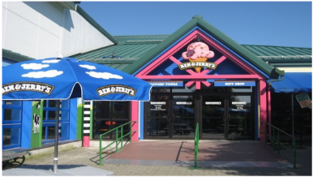
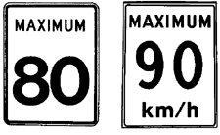
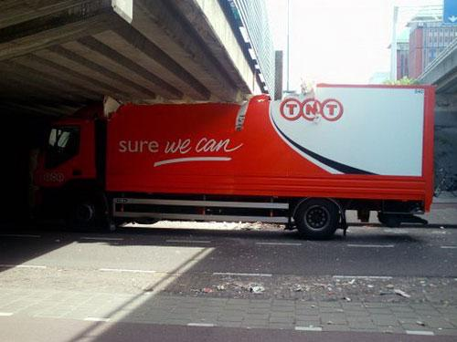
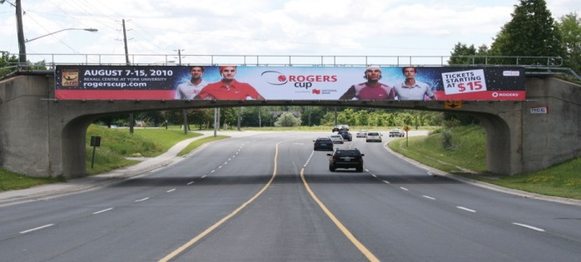
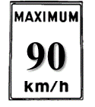
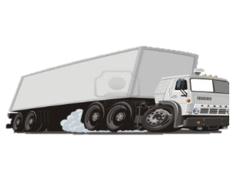
80
5 km
10 km
10 km
20 km
30 km
90
15 km
10 km
Notes:
Feel free to skip this slide.
I like to show it before the next yourturn:
“So, I bought an icecream shop! Now, the trucks that deliver the icecream to me take the route that will cost them the shortest amount of time since they don’t want the icecream to melt. Until recently, they took the middle route as it took the least amount of time. Unfortunately, <click> the city has just built a bridge over the middle route and the bridge is like an <click>inch too low for our trucks to pass under! So which alternate route should the trucks take? Which one is going to be faster? Can you build an algebraic equation to figure it out or can you do some rough calculations to decide which one? Who says the left route? Who says the right route? Left? Right? So, the answer is actually to take the middle route and to lower the air pressure in the truck tires so that it will sit 1 inch lower on the road! There is a lesson here! We don’t want to just jump in and start figuring out the solution. We want to take some time to understand the problem and look at it from different angles! Why am I brining this up? Because there are two ways to solve the next yourturn. Hint, if the problem gets increasingly difficult, you need to look at things from a different angle.

Slide 18
Week-05:yourturn1

Slide 19
Let’s talk about yourturn1
Week-05:yourturn1
Notes:
Here, I show them that they can save themselves a lot of work by calling the previously written findLargest methods so that each overloaded method can be only 1 line long.

Slide 20
Final & Enumerated Types
Week-05:finalenumberatedtypes:Start

Slide 21
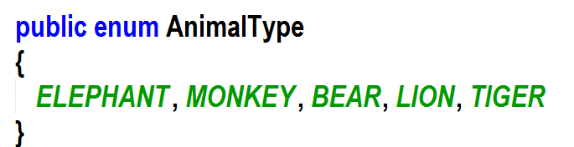
Enums
Enums allow us to force a list of certain values that a variable can be set to.
Enums cut down on spelling mistakes
Good practice to use Enums when the variable must be one of a few values.
This is the kind of thing that differentiates a great programmer from a mediocre coder

Slide 22
Deeper into enumerated types
Week-05:deeperenums:Start

Slide 23
A quick discussion of immutable objects
“An object is considered immutable if its state cannot change after it is constructed”
Basically, it is read-only
How do we make an object immutable?
Make all its instance variables final
Make the class itself final (we will learn about this when we discuss inheritance)
Ensure that no methods make any changes to the object’s state.
Immutable objects are preferred, when possible. (long story but trust me)
Think about our PizzaOrder. Could we make that immutable?

Slide 24
Moudle5:yourturn2:Part A
15 mins

Slide 25
Objects holding reference to other objects
Week-09-holdingareference: Start

Slide 26
Let’s draw the memory for our Car
Car
main
Horn
horn = @
honk (): void
Engine
start (): void
Notes:
You can exit slideshow mode and build this with the students or just skip to the next slide where it is complete

Slide 27
Completed Memory diagram
Horn
Engine
numCylinders = 8
honk (): void
start (): void
main
horn = @
engine = @
Car
car = @
Horn=@
Engine = @

Slide 28
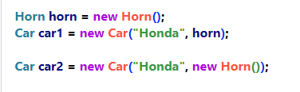
Important to know
Once the JVM sees new, it is going to instantiate an object, run the constructor, AND, return the address of the object
The returns the address of the Horn object which we put in the horn variable
Now, we’re passing the address of the Horn object to the constructor of the Car object.
Here, we’re doing the exact same thing but we’re cutting out the need to store the address in a variable. The new keyword will instantiate a Horn object and return the address of that object – Just like we held in the horn variable!
Notes:
Just a reminder that we don’t have to assign a variable to our object and then pass that variable into another method call. We can simply new up an object and pass it’s address directly

Slide 29
Week05:yourturn03.Start
15 minutes

Slide 30
Let’s build a Circus
Week-05:circus:Start

Slide 31
So, we built an Enumerated Type

Slide 32
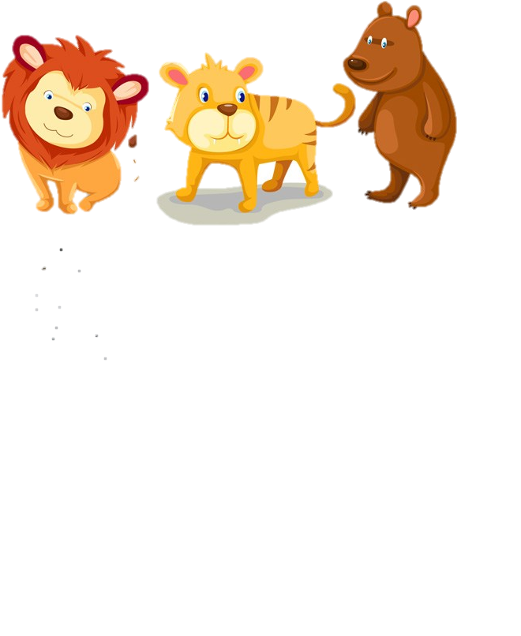
Animal
a1=@

Slide 33
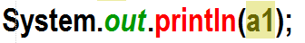
What will this print?
The address of the Animal Object
Animal
a1=@

Slide 34
How can we tell what kind of animal it is?
Animal
a1=@

Slide 35

Objects can hold a reference to other Objects
Cage
animal: Animal
Animal
Animal
We would like our Animal objects be able to live in Cage objects…

Slide 36
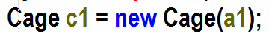
animal
Animal
c1=@
a1=@

Slide 37
How can we tell what kind of animal it is without using a1?
animal
Animal
c1=@
a1=@

Slide 38
Let’s build a Circus
Week-05:circus:Start - PartB

Slide 39
yourturn2:Part B
15 mins

Slide 40
YourTurn4
12 minutes

Slide 41
YourTurn5
12 minutes

